Slide 1

CSE 470/598 Procedural Textures and Perlin Noise
Ross Maciejewski
rmacieje@asu.edu

Slide 2
Disclaimer
These slides can only be used as study material for the class 470 at ASU
The slides cannot be distributed or used for another purpose
Further details on this topic are in: Texturing and Modeling: A Procedural Approach (The Morgan Kaufmann Series in Computer Graphics)

Slide 3
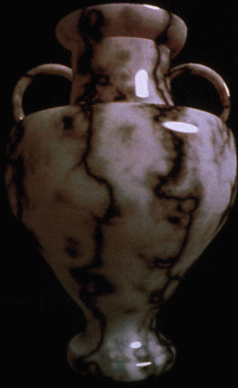
Procedural Texture
Computer generated image created using an algorithm
Goal is to create a realistic representation of natural elements
Wood
Mable
Granite

Slide 4
Why Use Procedural Textures?
Procedural textures provide an alternative to the choice of image base textures
Main tradeoff is between memory cost and execution time
For image based textures, need large amounts of memory and each processor retains a copy of every image texture for a given scene
For procedural textures, no image is needed, so bandwidth for transmitting and storage are virtually nil

Slide 5
How to Generate a Procedural Texture
Version 1: Static Texture
Define a 2D function f(s,t)
Sample the function at each texel
Version 2: Texture Animation
Define a 3D function f(s,t,r)
Create several slices with fixed r → set of textures
f(s,t, constant1), f(s,t, constant2), f(s,t, constant3), …

Slide 6
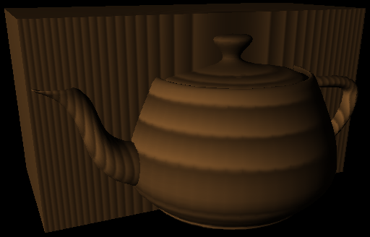
A Simple Wood Texture
Generate texture in memory
Woodmap (linear color interpolation)
Wood Function

Slide 7
Generate a Texture in Memory
#define TexWidth 128
#define TexHeight 128
static GLubyte textureImage[TexHeight][TexWidth][4];
for( i = 0; i < TexHeight ; i++)
for(j = 0; j < TexWidth; j++)
{
Vector4f colorvector; // RGBA color
colorvector = GenerateTexture(
i / (float)TexHeight, j / (float)TexWidth);
textureImage[i][j][0] = colorvector[0]; // red from 0 to 255
textureImage[i][j][1] = colorvector[1]; // green 0-255
textureImage[i][j][2] = colorvector[2]; // blue 0-255
textureImage[i][j][3] = colorvector[3]; // alpha 0-255
}

Slide 8
Linear Color Interpolation
Example: Wood colored color table
Woodmap(0) = brown “earlywood”
Woodmap(1) = tan “latewood”
Code Example:
Vector4f Woodmap(float a);
{
Vector4f earlywood( .. , .. , .. , ..);
Vector4f latewood( .. , .. , .. , ..);
return( (1-a) * earlywood + a * latewood );
}
0
1
Woodmap(f)

Slide 9
Wood Function
Wood function creates cylindrical shells
Outer rings closer together

Slide 10
Adding Realism?
The real world is not perfectly smooth!
The real world does not move or change in regular ways.
We can use a random function to make imagery or geometry appear more natural looking.
However, the random function found in math libraries aren’t usually suitable.
They result in a discontinuous function!
We want a random/noisy function that changes “smoothly”

Slide 11

Perlin Noise
The most famous practical solution to this problem came from Ken Perlin.
Developed Perlin Noise in the 1980s which is used in texture generation
Won a Technical Achievement Award from the Academy of Motion Picture Arts and Sciences in
Basic idea is to create a seeded random number series and smoothly interpolate between the terms in the series.

Slide 12
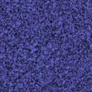
Perlin Noise
Noise – typically a 1, 2, or 3D function
Noise(s,t) =
s
t

Slide 13
Perlin Noise
Common technique is to create a 1/f^{n} noise
Such harmonic functions are known to occur often in natural processes
An approximation to this is to add suitably scaled harmonics of this basic noise function

Slide 14

Perlin Noise
These slides will use Noise(x) to refer to the Perlin Noise Function, where x is a vector of 1, 2, etc. dimensions.
The function Noise(x) will return a real (scalar) value.
A harmonic will be Noise(b x) where ‘b’ is some positive number greater than 1 (typically a power of 2).
Noise functions can be used by themselves, but a more common approach is to create a weighted sum of a number of harmonics of these functions

Slide 15
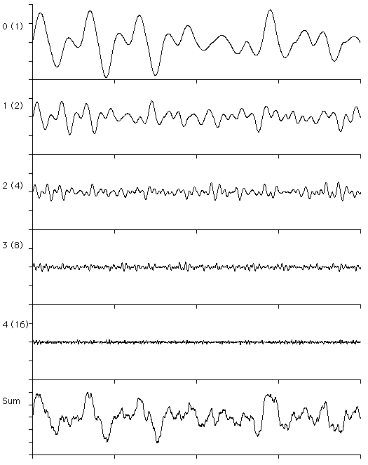
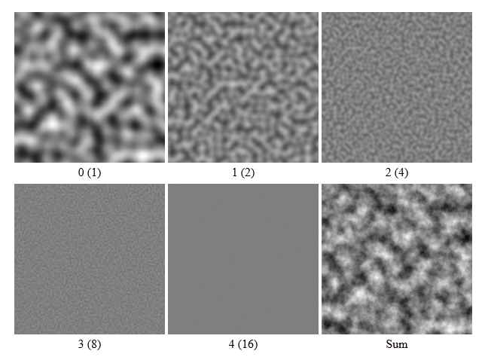
Harmonics
N is the number of harmonics you are adding together (a typical N is 6-10)
‘a’ controls how ‘rough’ the final noise function is, small values give very rough functions, large give very smooth

Slide 16
Using Noise
Amplitude a: power of noise effect
Frequency f_{s}, f_{t}, f_{r}: coarse v. fine detail
Phase: location of noise peaks

Slide 17
Procedural Noise Online
http://legakis.net/justin/MarbleApplet/

Slide 18
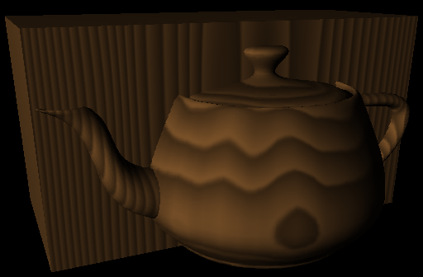
Using Noise
Add noise to cylinders to warp wood

Slide 19

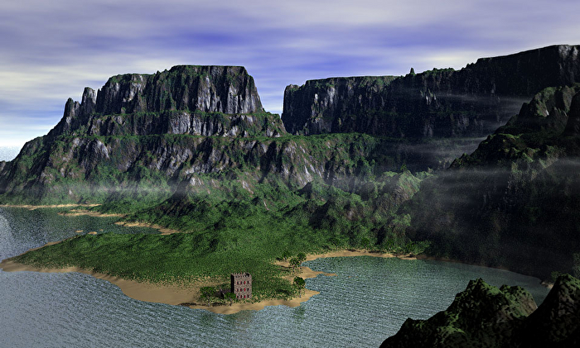
Clouds and Water
Gunther Berkus via Mojoworld

Slide 20
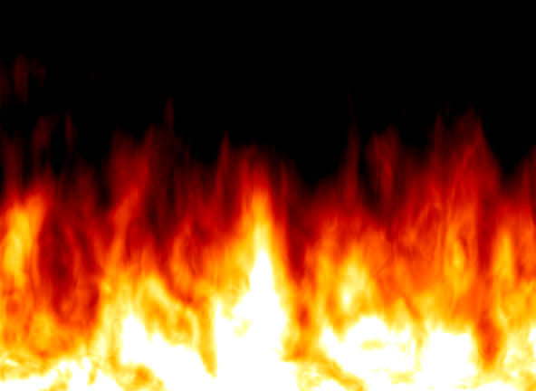
Fire
Ken Musgrave

Slide 21
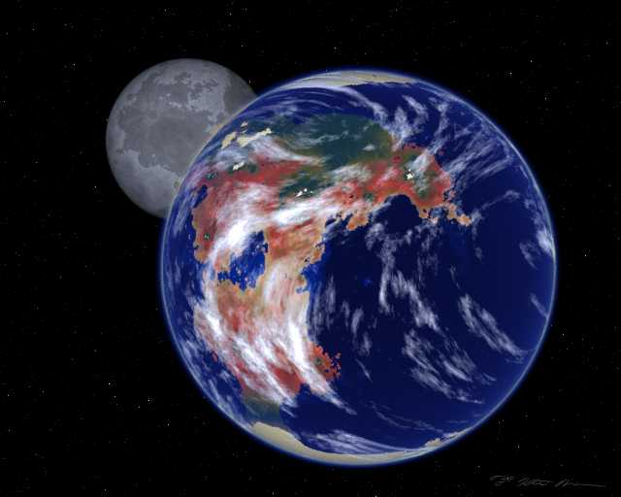
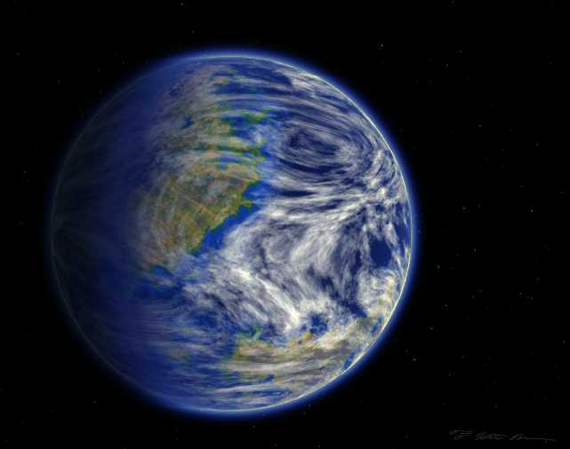
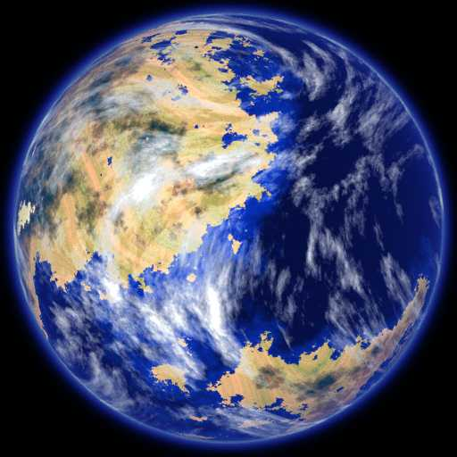
Planets
Ken Musgrave

Slide 22
Perlin Noise Implementation notes
Implementation Notes for the provided Noise class
Noise is 0 at all integer locations!!
e.g. Noise(3,4,1) = 0
Noise range is [-1, 1] !!
scaling is required to fit values into [0, 1] range
If you add up multiple noise frequencies → values can be outside the [-1, 1] range → you have to compute min and max for the texture → scale to [0,1] using computed min and max

Slide 23
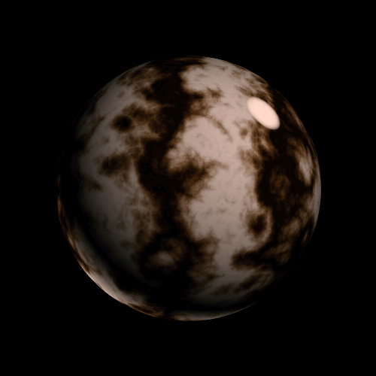
Marble Principle
Use sin function plus noise

Slide 24
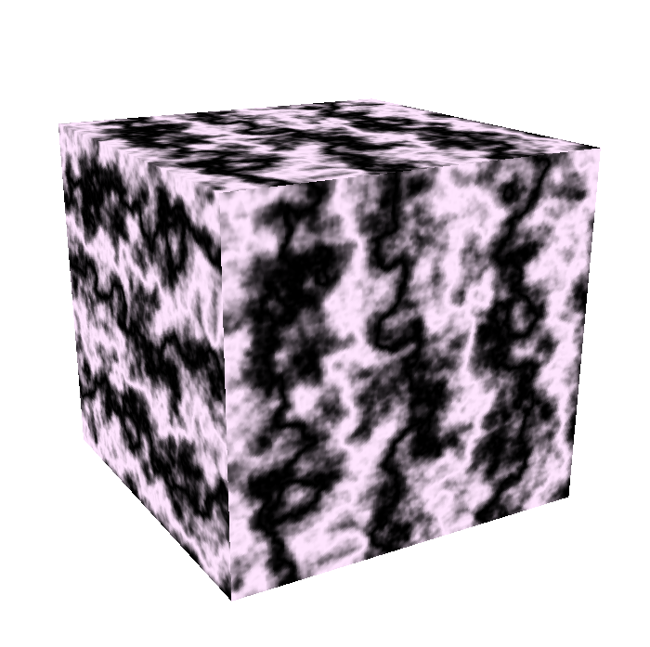
Marble Example
MarbleMap is from black to white
Scale scales [min, max] to [0,1]
u and v are in range [0,1]
Does not look that great, maybe a more complex color ramp is needed

